Slide 1
Week 5 Presentation
Wednesday, September 25, 2019
ATLAS Data analyst team:
Smruthi Iyengar
Kagen Jet Quiballo
Hanqing Wang
Yuxin Wang

Slide 2
Introduction
Re examining preliminary data with new data
Sample vs Population
Undergrads by Sex
Undergrads by Residency
Undergrads Year in School
College Distribution
Retention/Dropout rates
Average tuition by college

Slide 3
Sample v.s. Population
Fall 2017
 | Undergraduate | Graduate | Professional | Total
Population | 19,448 | 7,988 | 3,103 | 30,539
 | 63.68% | 26.16% | 10.16% | 100%
Sample | 18,976 | 7,687 | 3,159 | 29,822
 | 63.63% | 25.78% | 10.59% | 100%
Error | -0.0811% | -1.4545% | 4.2524%
Notes:
The first thing we do is to compare the sample with population.
By excluding the inactive students and graduated students in the early term, we get a sample with size of 29822 total students enrolled in Fall 2017. Among 29822 students, there is 18976 undergraduate students, 7687 graduate students, 3159 professional students. If we look at the second blue row and second yellow row, those are the percentage of the students in each of three levels among the population and sample. The last row represents the difference between each levels’ proportion in population and sample. As we can see, the sample and population are very similiar. So far, we can say the sample is a good representative of the population. Next, we are going to do a deep dive into the comparison of demographic distribution between sample and population. Thus, I am going to pass the speaker to Kagen.

Slide 4
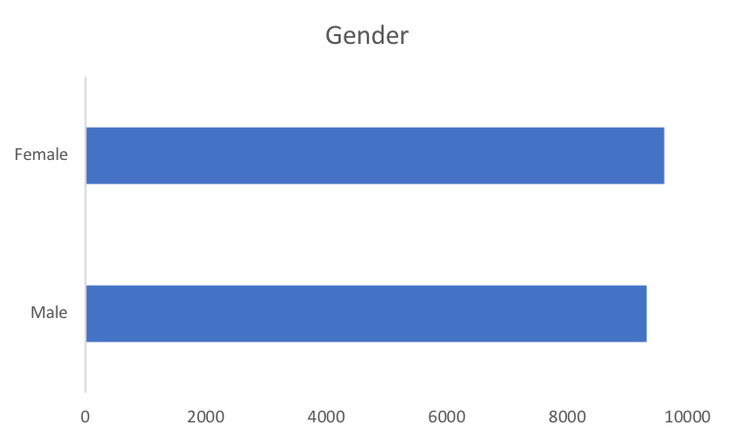
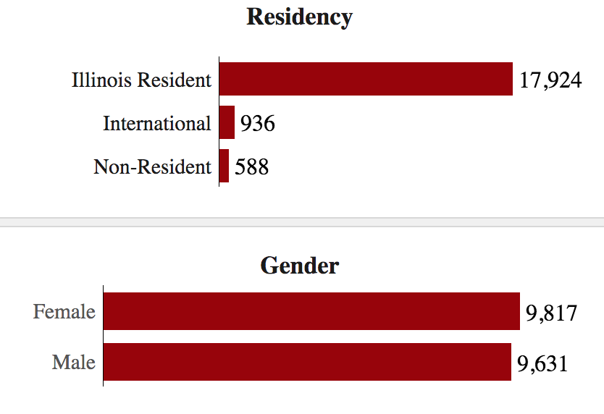
Distribution of F17 Undergrads by Sex
50.8%
9,614
BANNER DATA
49.2%
9,325
50.5%
UILLINOIS
49.5%
Notes:
Almost even distribution among sexes
Females have more
Less than .5% error for each

Slide 5
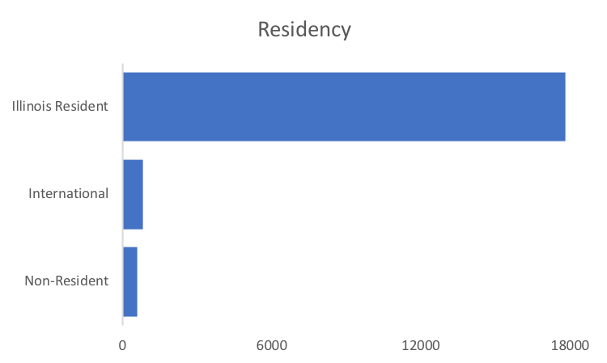
Distribution of F17 Undergrads by Residency
92.7%
17,826
BANNER DATA
821
577
92.2%
UILLINOIS
Notes:
Majority are ilinois resident.
Again less than half a percent error off from distr of uillinois
Compile all in state → illinois resident
Notes on double counting: (251 recounted → 9 are triple counted and 231 are double counted, 18,736 unique)
Of the 231 double counted:
International, In ST Tuition: 21
International, Out ST Tuition: 12
Non-Resident, In ST Tuition: 60
Non-Resident, Out ST Tuition: 52
Resident, In State Tuition: 83
Smruthi will talk abuot year in school for undergrads

Slide 6
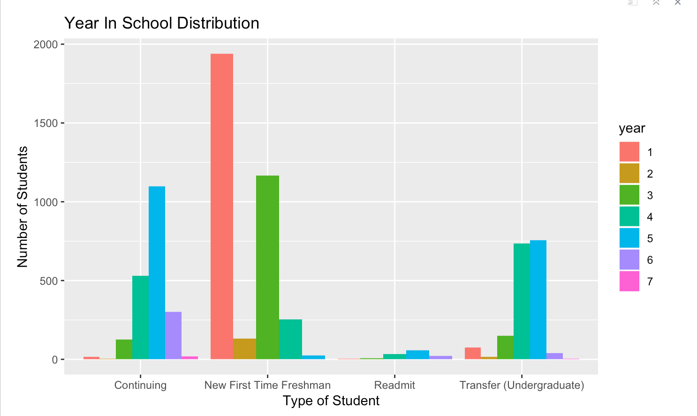
Undergrad Student’s Year in School

Slide 7
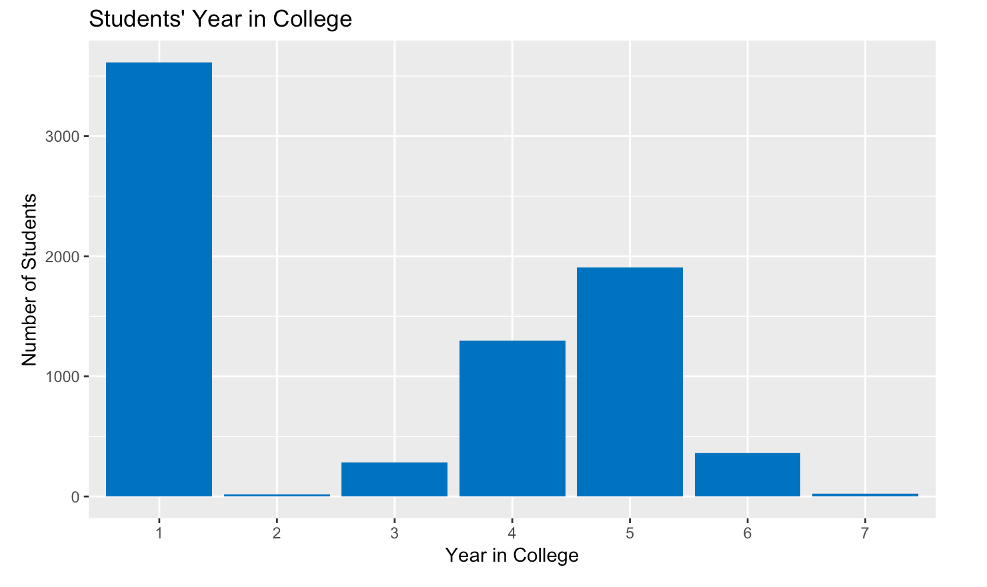
Updated Year in School
Changing all Students that are First Time Freshmen to year 1

Slide 8
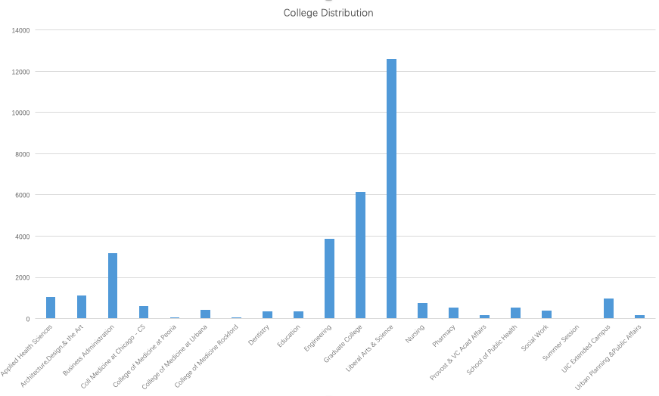
College Distribution

Slide 9
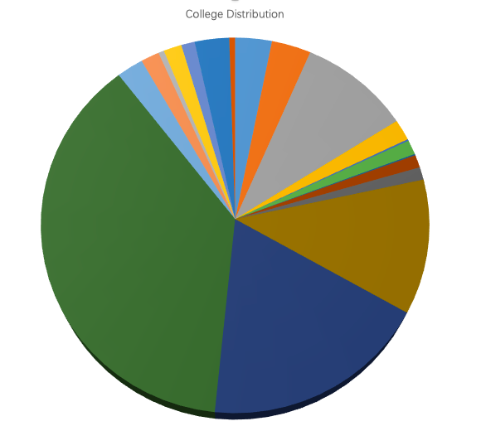
College Distribution for
Undergrad
Engineering
LAS
Business

Slide 10
Retention & Drop out
 | Undergraduate | Graduate | Professional | Total
# of continued | 12749 | 4416 | 2292 | 19457
# of drop out | 2321 | 939 | 106 | 3366
Drop out rate | 15.40% | 17.54% | 4.42% | 14.75%
Retention rate | 84.60% | 82.46% | 95.58% | 85.25%
Notes:
Since we can conclude that this sample is a good representative of the population, now we can take a look at the retention and drop-out. After excluding the students who graduated from 17/18 acdemic year and checking the remaining students’ credits taken in fall 2018, we get 12,749 undergraduate students who enrolled in fall 2017 continued their education in fall 2018, 2321 undergraduate students dropped out of school. There is 15.4% of undergraduate students who were supposed to continue dropped out. Among the graduate students, there is 17.54% of students who were supposed to continue dropped out. Also, graduate students have the highest drop-out rate. Among the professional students, the drop out is only 4.42%, which is the lowest comparing to other two levels of studies. Now I am going to give the speaker back to Yuxin, she is going to talk about the average tuition in each college.

Slide 11
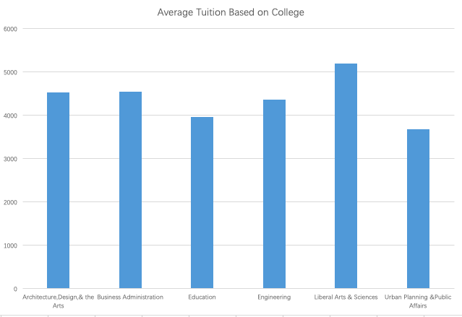
Average Tuition and Fees based on College

Slide 12
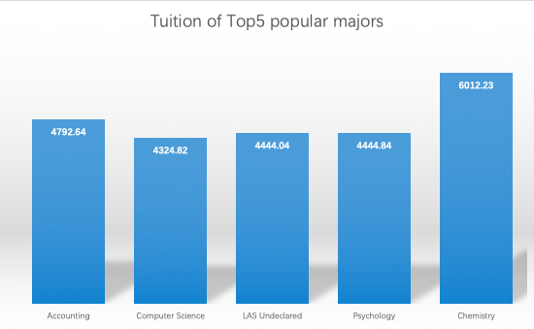
Average Tuition and Fees based on Majors

Slide 13
Conclusion
Sample vs. Population in sex and demographics: small error → representative
Retention: Professional (smallest dropout), Graduate has highest (highest)
Average tuition: most students generally from LAS
among the popular majors chemistry has the highest cost
Year in school based off credit hr: inaccurate

Slide 14
Thank you for listening!
Questions?

